Slide 1
Google Play Store Analysis
Bharat KNV
Achal Verma
Gourav Sutar
Jerin P.J

Slide 2
Summary
We, a group of 4 members, were assigned a mini project as a part of our learning process. The objective of the project was to analyse the Google Play Store app details i.e most popular apps, most popular category of apps etc.
The Play Store apps data has enormous potential to drive app-making businesses to success. Actionable insights can be drawn for developers to work on and capture the Android market.
We have used Hive to gather the insights and Excel to do the data preprocessing like data cleaning and the final report (graphs).

Slide 3
Data Cleaning
We have primarily used Microsoft Excel to perform the data cleaning process. The initial table given to us had a lot of duplicates, spelling mistakes and even missing values.
The spelling mistakes were fixed with the ‘find & replace’ function of Excel. The duplicate values were removed using the ‘remove duplicates’ function of Excel.
As for the missing values, we found out that those did not interfere with our data analytics process, hence we chose to ignore them.

Slide 4
Generating the table CSVs
Imported source CSV into a pandas dataframe
Converted date format from DD-Month-YY to YYYY-MM-DD
Generated IDs for each unique value in the required columns (Category, Genres etc.)
Created dataframes for each dimension table with de-duplicated column values and corresponding column IDs
Created dataframe for the fact table with all the required columns and IDs
Wrote all dataframes to CSV files

Slide 5
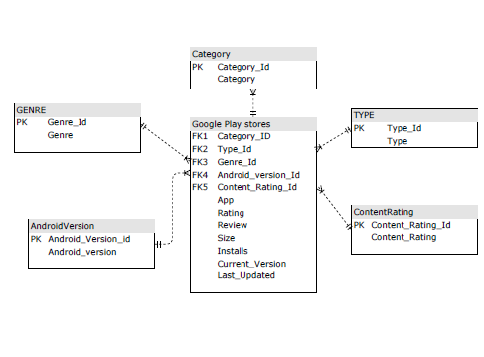
Database Structure

Slide 6
QUERY 1 & 2
APP COUNT BY CATEGORIES
SELECT c.category, COUNT(p.category_id) as num_apps
FROM Category c JOIN play_store p
ON c.category_id = p.category_id
GROUP BY c.category;
APP COUNT BY GENRE
SELECT g.genre, COUNT(p.genre_id) as num_apps
FROM Genre g JOIN play_store p
ON g.genre_id = p.genre_id
GROUP BY g.genre;

Slide 7
QUERY 3 & 4
NUMBER OF INSTALLS FROM INDIVIDUAL GENRES
SELECT g.genre,SUM(ps.installs)
FROM genre g join play_store ps
ON g.genre_id = ps.genre_id
GROUP BY g.genre;
TOP 3 CATEGORIES BASED ON INSTALLS
SELECT c.category,SUM(ps.installs) as ca
FROM Category c join play_store ps
ON c.category_id = ps.category_id
GROUP BY c.category
ORDER BY ca DESC
LIMIT 3;

Slide 8
QUERY 5 & 6
TOP 20 APPS OF GAME CATEGORY
SELECT c.category,p.app,p.installs
FROM category c JOIN play_store p
ON c.category_id=p.category_id
WHERE c.category="GAME"
ORDER BY p.installs DESC
LIMIT 20;
TOP 20 APPS OF COMMUNICATION CATEGORY
SELECT c.category,p.app,p.installs
FROM category c JOIN play_store p
ON c.category_id=p.category_id
WHERE c.category="COMMUNICATION"
ORDER BY p.installs DESC
LIMIT 20;

Slide 9
QUERY 7 & 8
TOP 20 APPS OF SOCIAL CATEGORY
SELECT c.Category AS Category, p.App AS App_Name, p.installs AS No_Of_Installs
FROM Category c JOIN play_store p
ON c.category_id = p.category_id
WHERE c.Category = 'SOCIAL'
ORDER BY No_Of_Installs DESC
LIMIT 20;
TOP 10 APP CATEGORY FOR TEENS
SELECT c.category AS Category, COUNT(p.App) AS No_Of_Apps
FROM Category c, play_store p, Content_Rating cr
WHERE p.content_rating_id = cr.content_rating_id
AND c.category_id = p.category_id
AND cr.content_rating = 'Teen'
GROUP BY c.category
ORDER BY No_Of_Apps DESC
LIMIT 10;

Slide 10
THANK YOU
GITHUB: https://github.com/bharatknv/Case-Study-1

